Slide 1



22-08-2023
FACTORED DATATHON 2023
Cristina Gomez
Daverson Arenas

Slide 2


CRISTINA GOMEZ
PAISA GENIOUS TEAM
DAVERSON ARENAS
Bioengineer and Data Scientist:
As the lead data scientist in our project Cristina:
Managed feature engineering, data cleansing, and conducted data mining to create insightful visualizations
Constructed the gold data set, essential for visualization and ML models
Executed machine learning models for sentiment analysis, enhancing project insights
Mechanical Engineer and Data Engineer
As the lead data engineer in our project Daverson:
Orchestrated Databricks workspace deployment on AWS, integrating Github for efficient CI/CD.
Designed lakehouse data architecture, unifying data warehouses and data lakes.
Created ELT pipelines for batch and streaming incremental data ingestion

Slide 3




Datathon Challenge Roadmap
Stage 5
Machine learning models, frontend design, final design dashboard, documentation and presentation
The Challenge
Stage 4
Create an innovative data solution (web apps, chatbots, dashboards, model interfaces...) to empower businesses with insights from product reviews.
Data engineering for streaming, data cleansing, feature engineering and data visualization. Combine the data from both sources
Day 12 Day 13
Stage 3
Data architecture design, data engineering for batch and stream ingestion. Exploratory data analysis
Day 9 Day 11
Stage 2
Choose technologies, deploy services, set up workspace and create GitHub repo. First batch ingestion
Day 6 Day 8
Stage 1
Understand the problem and define a solution approach.
Day 3 Day 5
Day 1 Day 2

Slide 4



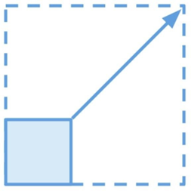








MAIN TECHNOLOGIES
DATABRICKS + APACHE SPARK
Databricks combines data warehouses & data lakes into a lakehouse architecture.
Scalability,
Parallelism and Speed
AWS + DELTA LAKE
Amazon S3 serves as the data lake, coupled with Delta Lake, which functions as the storage layer
AWS EC2 instances as the compute resources for Databricks clusters
MARKET
heterogeneous
hardware
MLFLOW + TEXTBLOB + NLTK
Distributed capabilities for large-scale experiments
Efficient experiment tracking, reproducibility and scalability
Optimized resource utilization

Slide 5
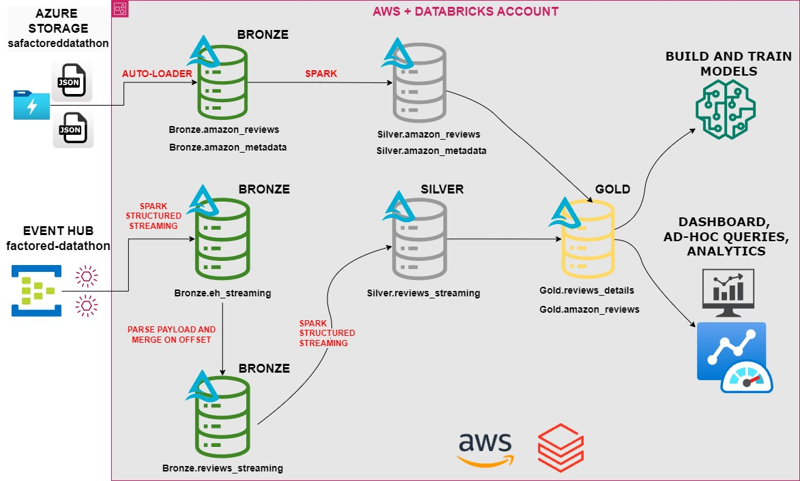
DATA ARCHITECTURE
For this challenge, Team Paisa Genious proposes a Delta Lakehouse architecture using Databricks with AWS Cloud, which offers an integrated solution for both batch and streaming data processing
Databricks:
Big data platform
AWS:
Storage
Compute resources

Slide 6
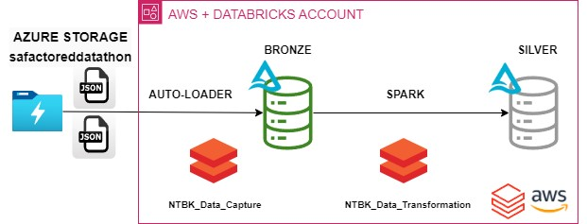
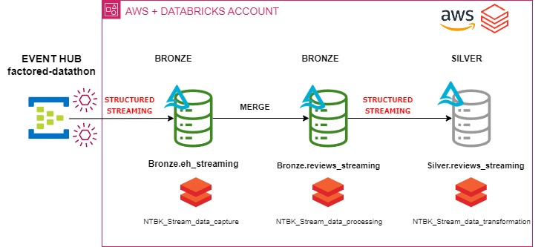
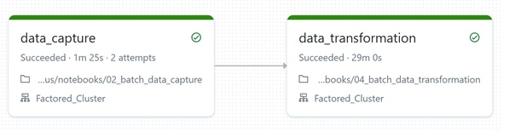
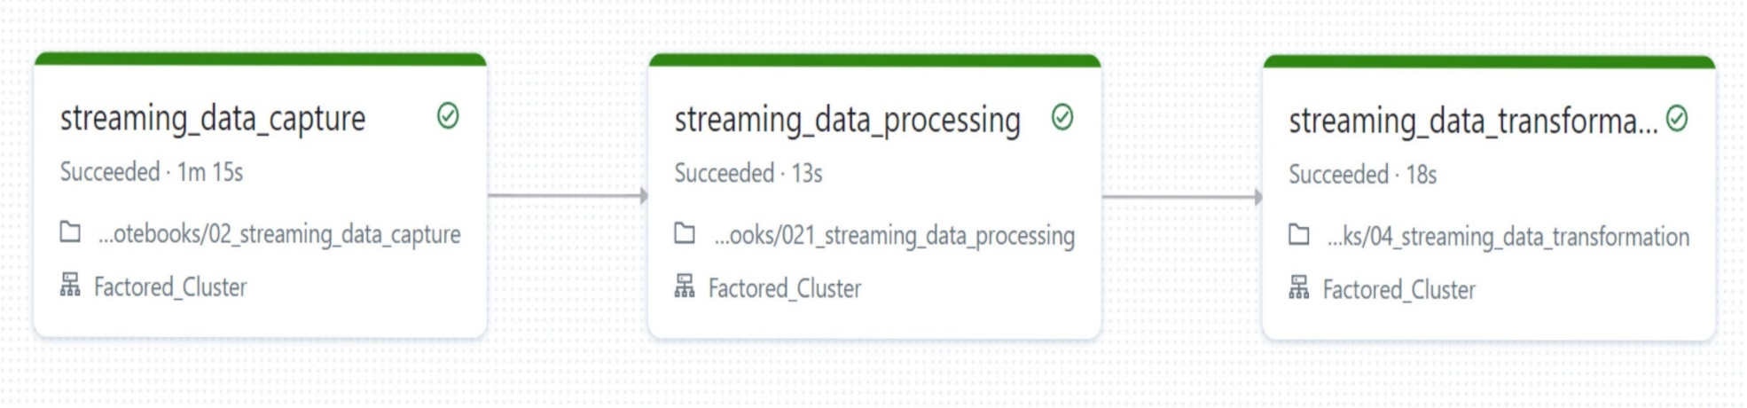
DATA ENGINEERING WITH DATABRICKS
BATCH
1. Extract and Load data to the Lake house
Auto-loader: Incrementally load new data files as they arrive
2. Transform, Clean and Filter
Spark structured streaming: Processing and transformation tasks with a batch-like behavior
STREAMING
1. Extract and Load data to the Lake house
Spark structured streaming: Stream data from event hub
2. Transform Data, Clean and Filter
Spark structured streaming: Processing and transforming tasks as data becomes available

Slide 7
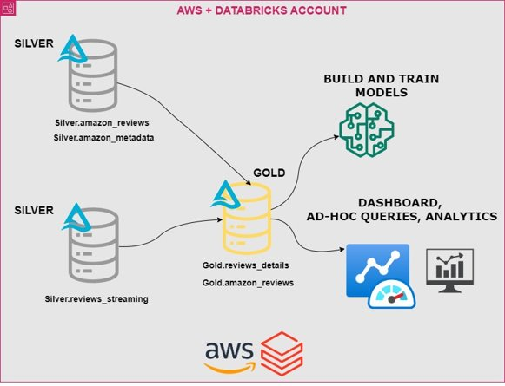
DATA ENGINEERING WITH DATABRICKS Gold Layer: Business level Aggregates
The Gold layer aims to deliver continuously updated, clean data to downstream users and applications, including machine learning models, ad-hoc queries, and analytics tools.

Slide 8
EXPLORATORY DATA ANALYSIS
Data cleaning
Feature exploration
New variables
Pattern recognition
Report generation
-Missing values and duplicate records.
-Variables imputation: price, main_cat, brand, title.
-Removing unwanted characters, converting to lowercase, and handling special cases: reviewText, title, main_cat, brand
-Number of unique customers,.
-Number of unique products.
-Number of unique reviews
-"Month"
-"Year"
-"Sentiment": positive, negative and neutral
-Number of words per review
Time Series analysis:
-Number of review per year.
Number of review per month.
-average of overall ratings per year
-Setiment analysis per year
FINAL
DASHBOARD

Slide 9
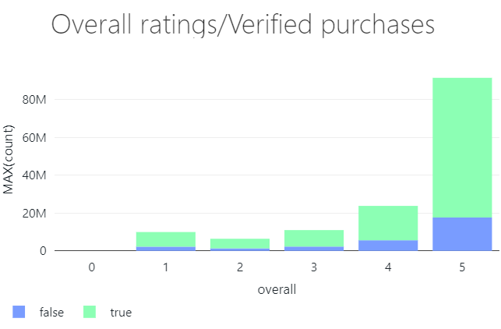
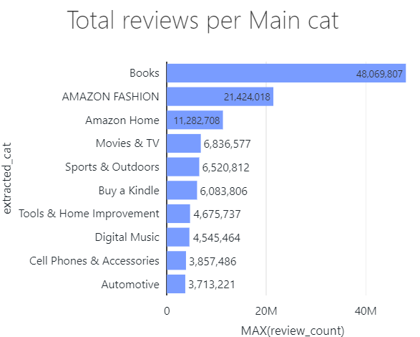




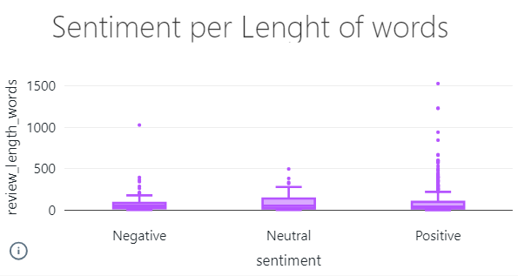
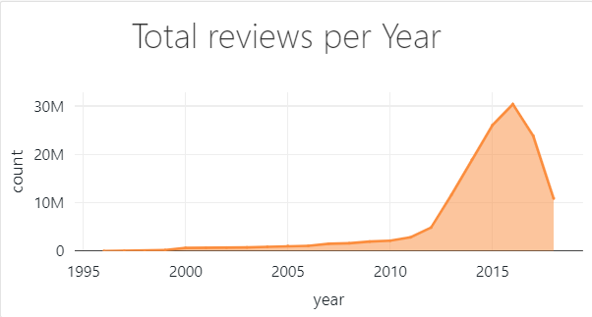

REPORT FROM HISTORICAL DATA
Review Verification Impact:
Does sentiment differ between verified and non-verified reviews, and do verified reviews tend to be more credible?
Review Length and Sentiment:
Are longer or shorter reviews more likely to have a positive or negative sentiment?
Product Prioritization:
Which product categories receive the most feedback, and are they also the ones with higher satisfaction?

Slide 10



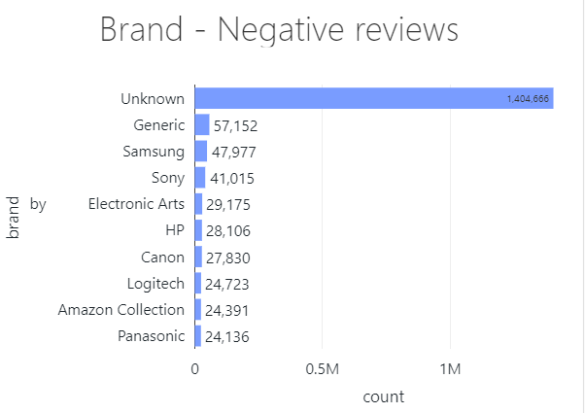
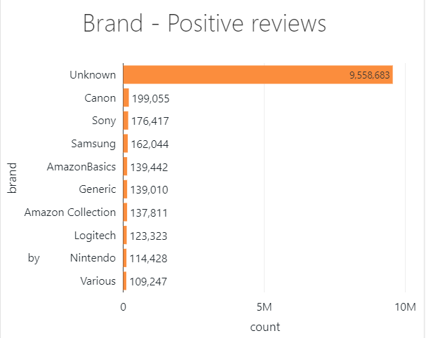
SENTIMENT ANALISYS FROM HISTORICAL + STREAMING DATA
BRAND REPUTATION ASSESSMENT
STRATEGIC DECISION MAKING
CUSTOMER PERCEPTION

Slide 11

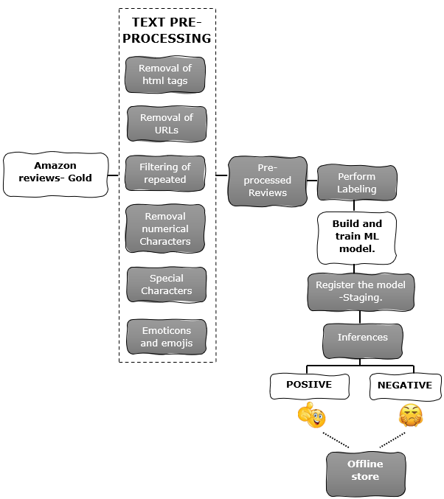



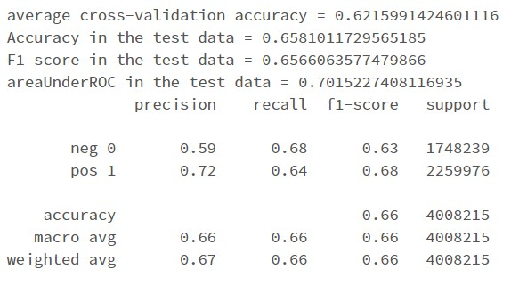


SENTIMENT ANALYSIS ML MODEL

Slide 12
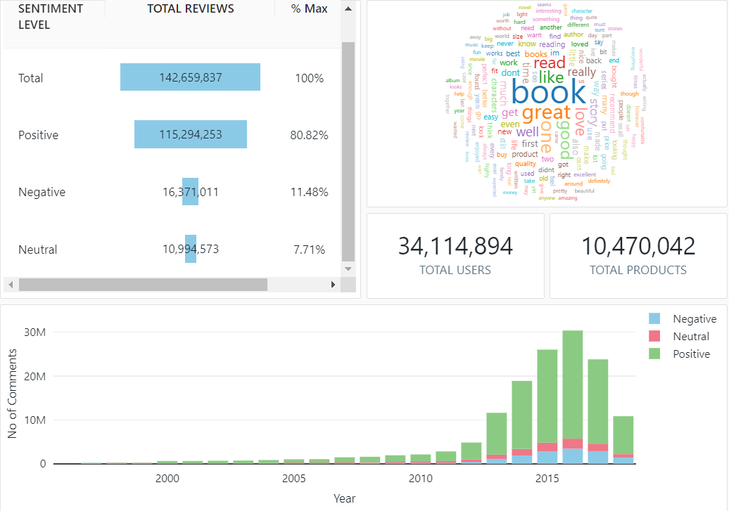
SENTIMENT ANALISYS DASHBOARD
Identifying Key Themes
Prioritizing Focus Areas
Sentiment Overview
Monitoring Trends
Customer Engagement
Historical Insights
Seasonal Patterns

Slide 13



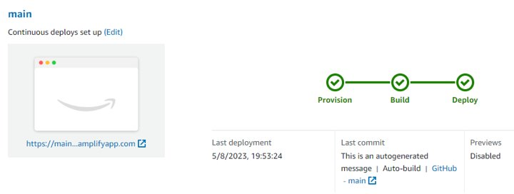


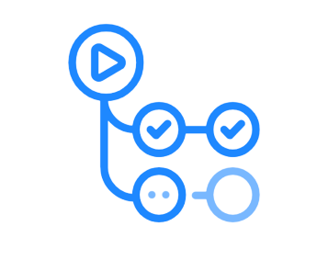
FRONTEND AND CONTINOUS DEPLOYMENT
AWS Amplify
HOST WEB APP
BUILD AND PROVISION APP
DEPLOY
DASHBOARD
Local Dev Commit
Automatic Deployment
Frontend and Dashboard
GitHub Repository
AWS Amplify
main
Pull Request
Main
Dev
GitHub Actions

Slide 14

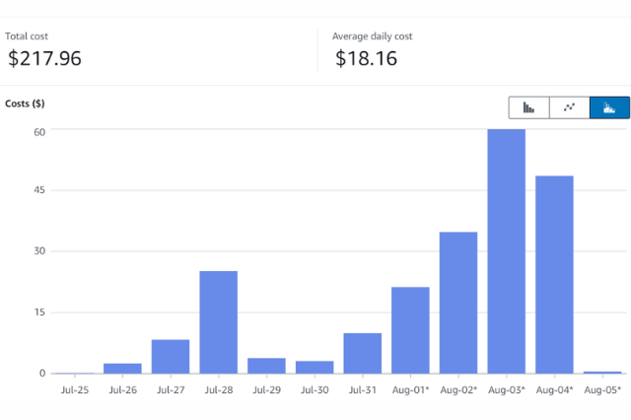


CHALLENGES AND CONCLUSIONS
AWS DAILY COST RESOURCES
SMALL TEAM
LIMITED TIME FRAME
LIMITED RESOURCES

Slide 15
PAISA GENIUS TEAM
22-08-2023
THANKS FOR YOUR ATTENTION

